Slide 1
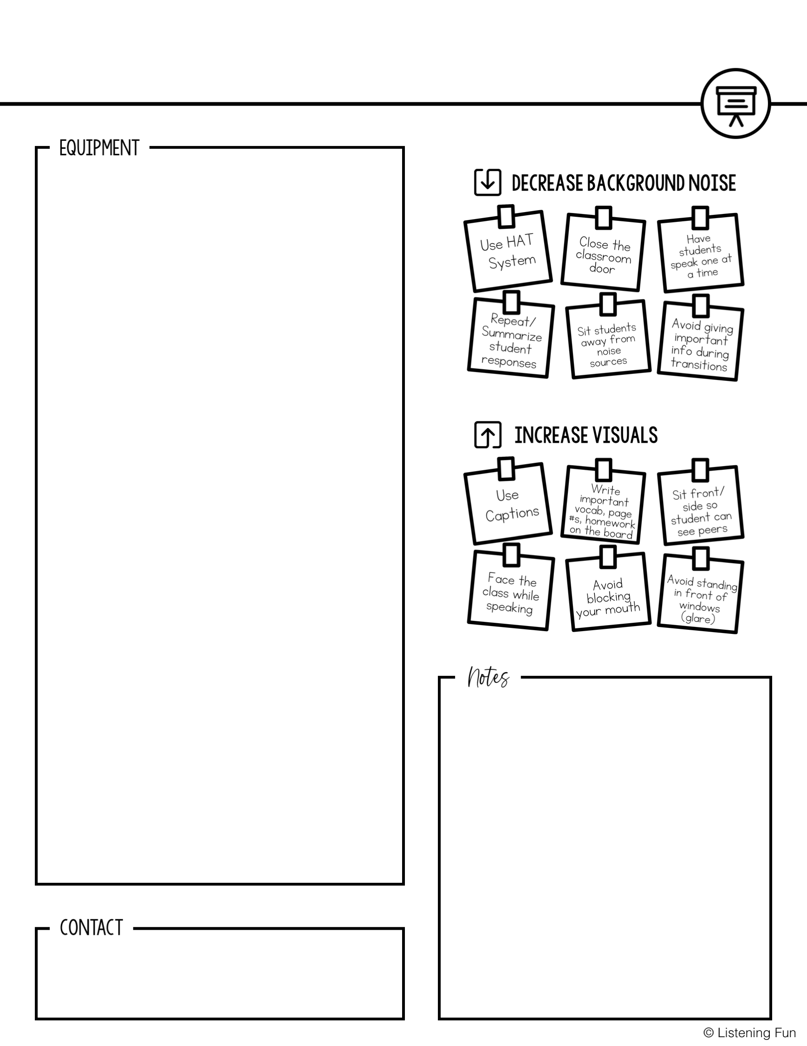
EDUCATING STUDENTS WITH HEARING LOSS
In-Service Training
Insert picture and explanation of hearing aids, CI, HAT, etc.
Name, title
Email
Phone

